Slide 1
checkpoint="never"
stage0
0,0
1,0
1,0
0,0
stage1
0,1
1,1
1,1
0,1
batch=0,stage=0->1
NativeLayerNormBackward0(null0)
Wait
(cp00等null0)
copy
(cp00->cp01)
Wait
(null1等cp01)
PermuteBackward0(null1)
#Wait
#(cp01等null1)
cat
fork
batch=1,stage=0->1
NativeLayerNormBackward0(null0)
Wait
(cp00等null0)
copy
(cp10->cp11)
Wait
(null1等cp11)
PermuteBackward0(null1)
#Wait
#(cp11等null1)
join

Slide 2
checkpoint="always"
stage0
0,0
1,0
1,0
1,0
0,0
0,0
stage1
0,1
1,1
1,1
1,1
0,1
0,1
前向checkpoint是模型前向，后向recompute是模型后向之前的前向，后向checkpoint是模型后向
Wait等重计算，令checkpoint等copy
batch=0,stage=0->1
Checkpoint
(null0)
Wait
(cp00等null0)
copy
(cp00->cp01)
Wait
(null1等cp01)
Checkpoint
(null1)
#Wait
#(cp01等null1)
fork
join
fork
join
fork
cat
recompute
phony
recompute
phony
batch=1,stage=0->1
Checkpoint
(null1)
Wait
(cp10等null0)
copy
(cp10->cp11)
Wait
(null1等cp11)
Checkpoint
(null1)
#Wait
#(cp11等null1)
fork
join
fork
join
join
recompute
phony
recompute
phony

Slide 3
checkpoint="except_last"
stage0
0,0
1,0
1,0
0,0
0,0
stage1
0,1
1,1
1,1
0,1
0,1
前向checkpoint是模型前向，后向recompute是模型后向之前的前向，后向checkpoint是模型后向
batch=0,stage=0->1
Checkpoint
(null0)
Wait
(cp00等null0)
copy
(cp00->cp01)
Wait
(null1等cp01)
Checkpoint
(null1)
#Wait
#(cp01等null1)
fork
join
fork
join
fork
cat
recompute
phony
recompute
phony
batch=1,stage=0->1
NativeLayerNormBackward0
(null0)
Wait
(cp10等null0)
copy
(cp10->cp11)
Wait
(null1等cp11)
PermuteBackward0
(null1)
#Wait
#(cp11等null1)
join

Slide 4
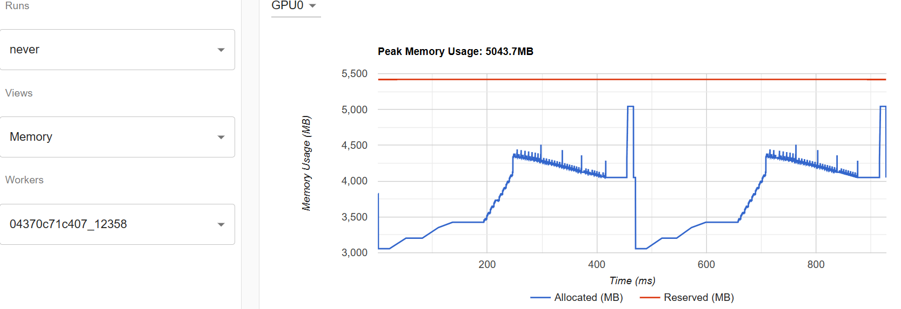
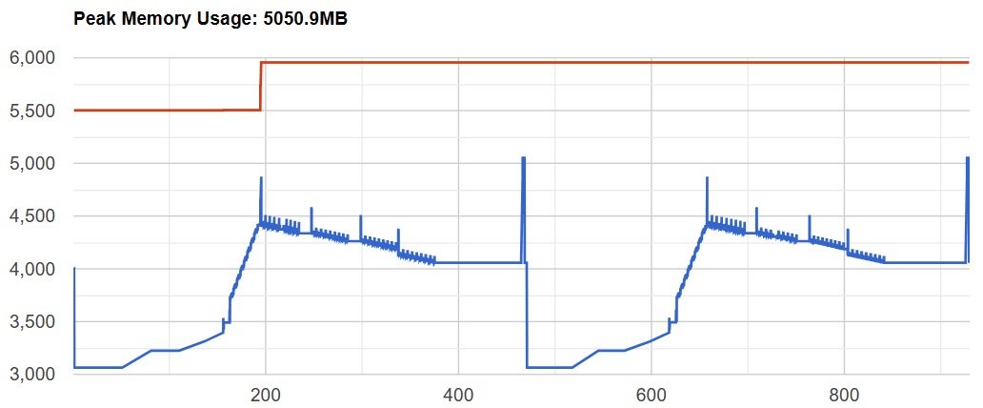

Slide 5
